Slide 1
INVENTRA – Intelligent Inventory Management System

Slide 2
Table of Contents
Module 1: Authentication Module - User Registration & Login
Module 2: Product/Inventory Management - Stock Control
Key Classes & Architecture
Complete Pseudocode Implementation
Data Flow Diagrams

Slide 3
Module 1: Authentication Module
The Authentication Module is the foundation of the Inventra – Intelligent Inventory Management System. It ensures that only authorized users can access the system and perform actions based on their roles.
User Registration (Sign-Up)
User Login (Sign-In) with JWT Tokens
Forgot Password Recovery
Password Reset Functionality

Slide 4
KEY CLASSES - AUTHENTICATION
AuthController: Handles authentication HTTP requests.
AuthService: Contains authentication business logic.
User: Represents user data model.
UserRepository: Manages user database operations.
JWTUtility: Generates and verifies JWT tokens.
EmailService: Sends authentication-related emails.

Slide 5
AUTHENTICATION MODULE – PSEUDOCODE
Sign-Up (Register User)
CLASS AuthController
FUNCTION signup(request)
userDetails = request data
result = AuthService.registerUser(userDetails)
RETURN result
END FUNCTION
END CLASS
Explanation
UI sends signup details
Controller forwards request to service
Controller does not validate business rules

Slide 6
Sign-Up Service Implementation
CLASS AuthService
FUNCTION registerUser(userDetails)
existingUser = UserRepository.findByUsername(...)
IF existingUser exists RETURN "User already exists"
encryptedPassword = encrypt(userDetails.password)
newUser = create User
newUser.username = userDetails.username
newUser.password = encryptedPassword
newUser.email = userDetails.email
UserRepository.save(newUser)
RETURN "Signup successful"
END FUNCTION
END CLASS
Step-by-step Explanation
Check if username already exists
Encrypt password for security
Create new user object
Save user in database
Return success message

Slide 7
Sign-In (Login User) – Controller
CLASS AuthController
FUNCTION signin(request)
username = request.username
password = request.password
token = AuthService.authenticate(...)
RETURN token
END FUNCTION
END CLASS

Slide 8
Sign-In Service Implementation
CLASS AuthService
FUNCTION authenticate(username, password)
user = UserRepository.findByUsername(username)
IF user does not exist RETURN "Invalid username"
IF password matches encrypted password THEN
token = JWTUtility.generateToken(user)
RETURN token
ELSE
RETURN "Invalid password"
END IF
END FUNCTION
END CLASS
Explanation
Verifies username
Verifies password
Generates JWT token
Token used for future authorization

Slide 9
Forgot Password - Service Logic
CLASS AuthService
FUNCTION processForgotPassword(email)
user = UserRepository.findByEmail(email)
IF user does not exist RETURN "Email not registered"
resetToken = generateResetToken()
save resetToken with user
EmailService.sendResetLink(email, resetToken)
RETURN "Password reset link sent"
END FUNCTION
END CLASS

Slide 10
Reset Password Implementation
CLASS AuthService
FUNCTION resetPassword(token, newPassword)
user = find user by reset token
IF token invalid or expired RETURN "Invalid token"
encryptedPassword = encrypt(newPassword)
user.password = encryptedPassword
clear reset token
save user
RETURN "Password reset successful"
END FUNCTION
END CLASS

Slide 11
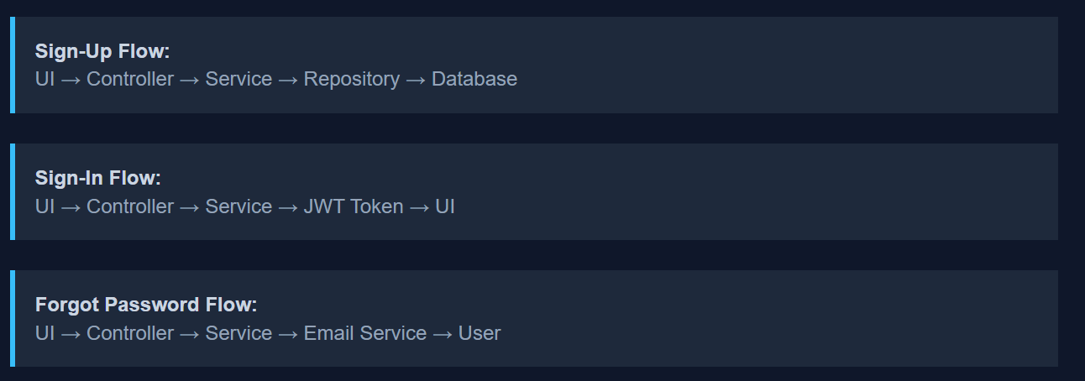
Authentication Flow

Slide 12
Module 2: Product/Inventory Management
The Inventory Management Module is the core operational module of the Inventra system. It is responsible for tracking, updating, and managing stock levels in real time.
Add and manage products
Track stock-in and stock-out operations
Prevent duplicate items using SKU
Monitor minimum stock levels

Slide 13
Product Class - Entity Model
CLASS Product
productId (Primary Key)
sku (Unique - prevents duplicates)
name
category
supplier
unitPrice
stockQuantity
minStockLevel
END CLASS
Explanation
sku ensures uniqueness
stockQuantity changes frequently
minStockLevel used for alerts

Slide 14
ProductController - Main Operations
CLASS ProductController
FUNCTION addProduct(productData)
ProductService.addProduct(productData)
END FUNCTION
FUNCTION stockIn(productId, quantity)
ProductService.increaseStock(...)
END FUNCTION
FUNCTION stockOut(productId, quantity)
ProductService.decreaseStock(...)
END FUNCTION
END CLASS
Explanation
Receives UI requests
Sends work to service layer
Does not touch database directly

Slide 15
ProductService - Add Product Logic
CLASS ProductService
FUNCTION addProduct(productData)
IF ProductRepository.findBySku(sku) exists
RETURN "Product already exists"
newProduct = create Product
newProduct.sku = productData.sku
newProduct.name = productData.name
newProduct.unitPrice = productData.unitPrice
newProduct.stockQuantity = 0
ProductRepository.save(newProduct)
RETURN "Product added successfully"
END FUNCTION
END CLASS

Slide 16
Stock In & Stock Out Operations
FUNCTION increaseStock(productId, quantity)
product = ProductRepository.findById(productId)
IF product is null RETURN "Product not found"
product.stockQuantity += quantity
ProductRepository.save(product)
END FUNCTION
FUNCTION decreaseStock(productId, quantity)
product = ProductRepository.findById(productId)
IF product.stockQuantity < quantity
RETURN "Insufficient stock"
product.stockQuantity -= quantity
ProductRepository.save(product)
END FUNCTION

Slide 17
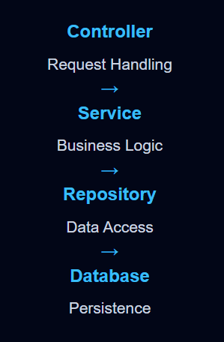
Layered Architecture

Slide 18
THANK YOU !!!!!!

